Slide 1




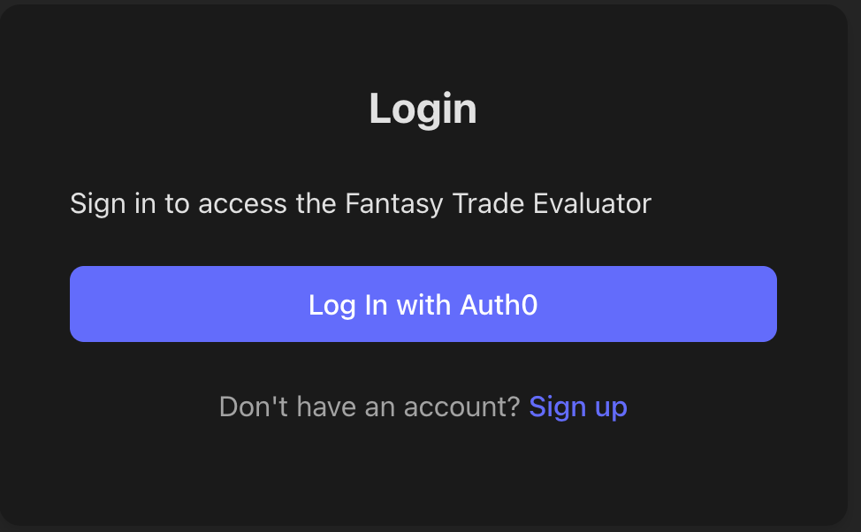
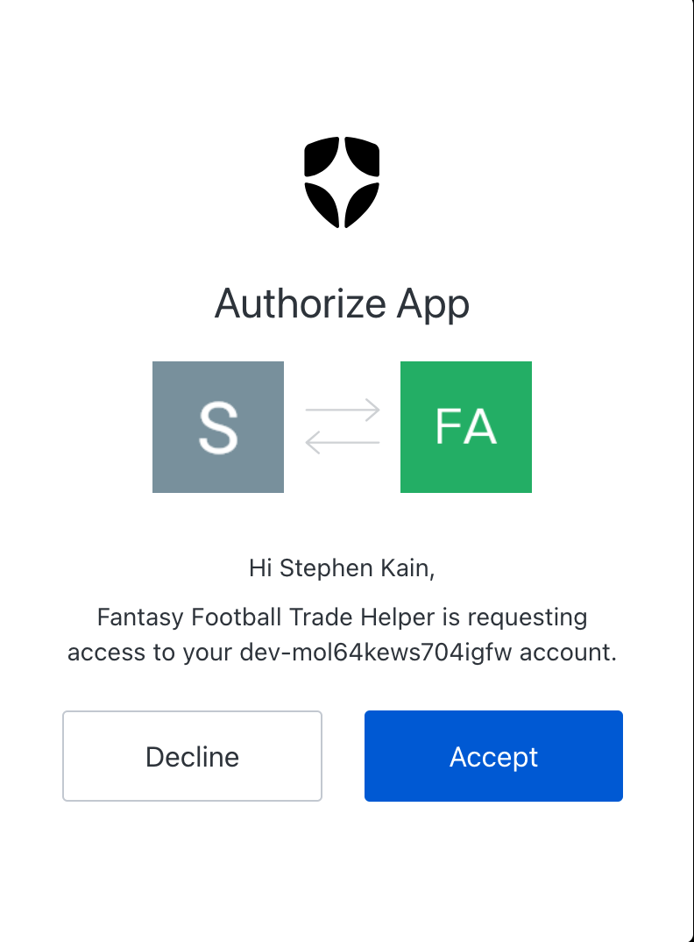
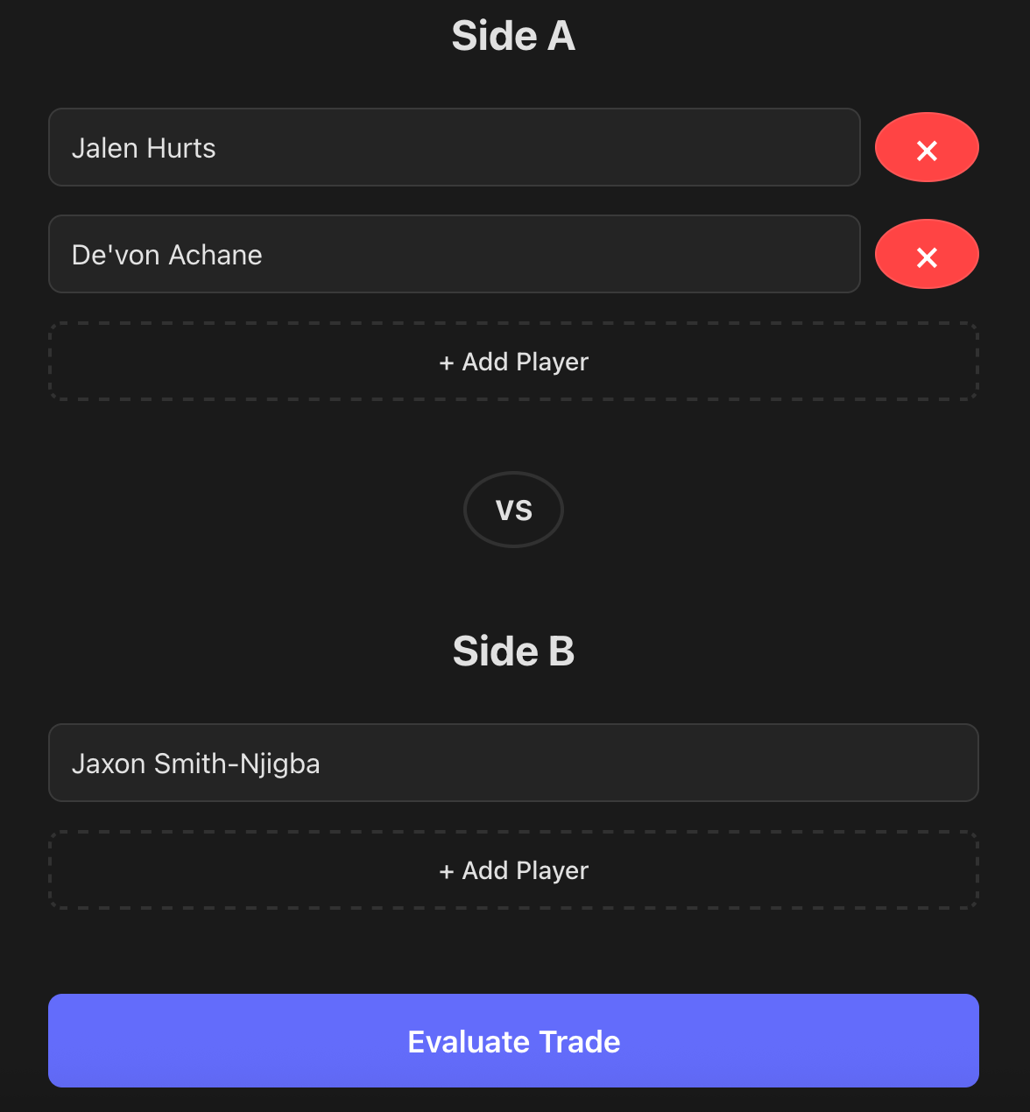

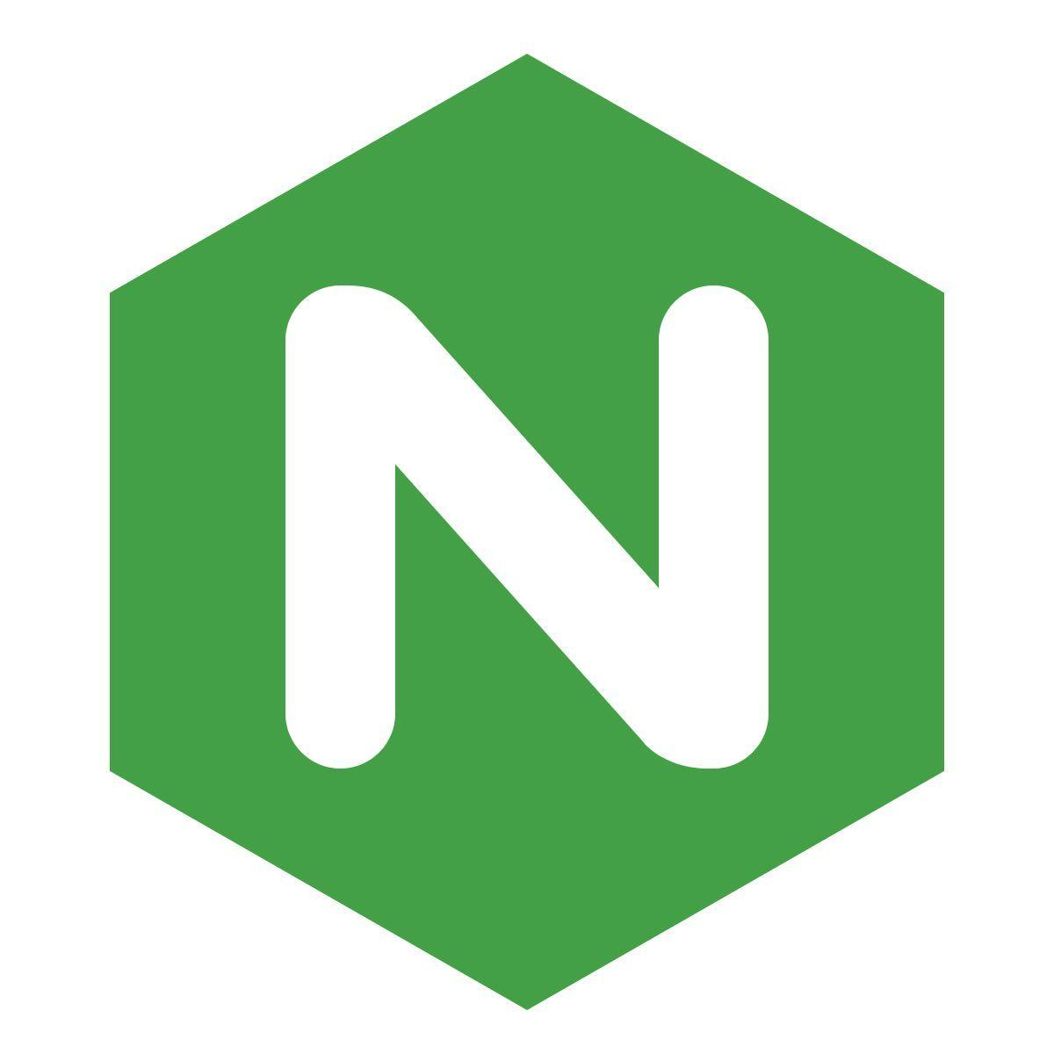





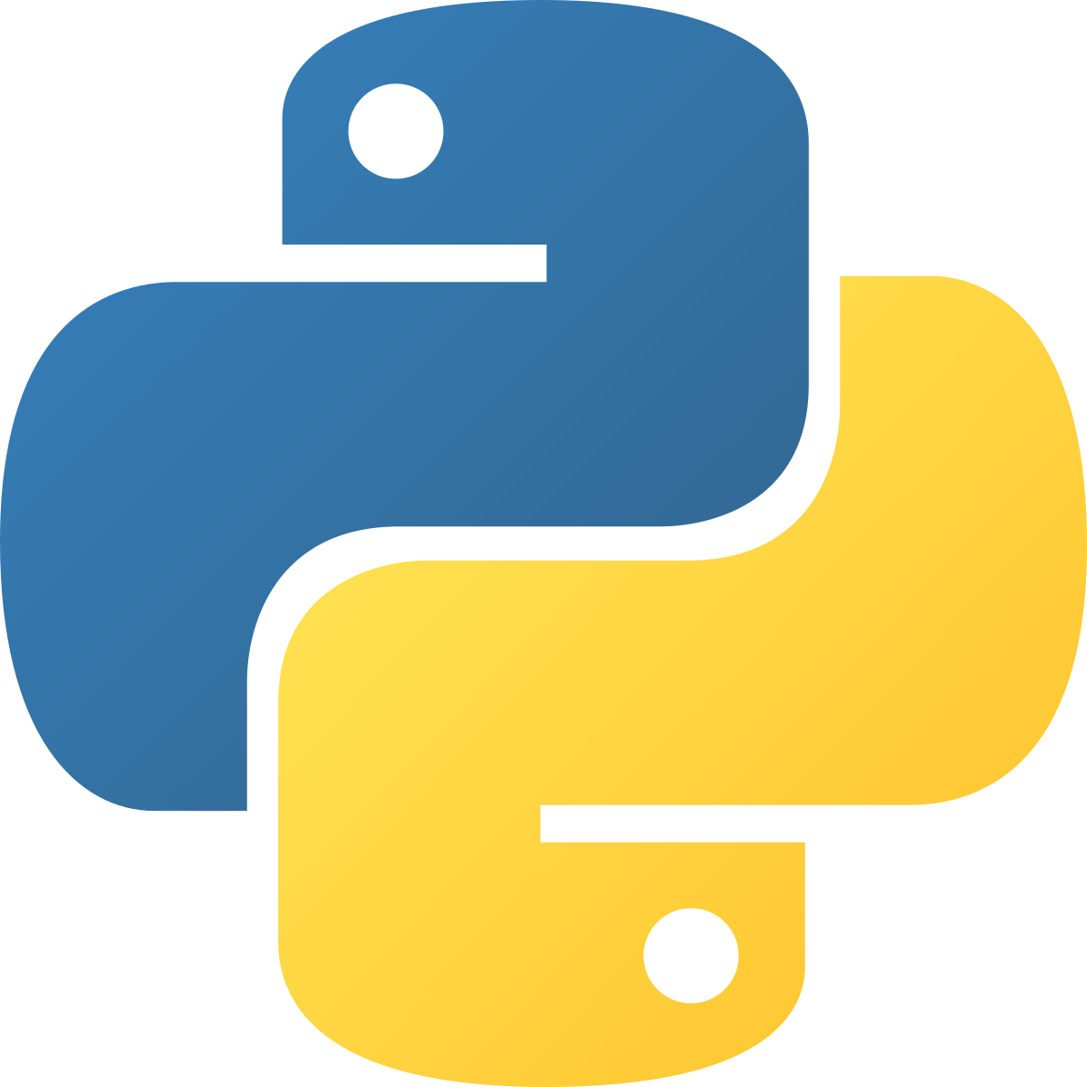

LevelField
Cloud-Native Full-Stack Deployment
Kubernetes Architecture
Michael Davis, Stephen Kain, Vance Keesler, Matthew Sheehan
LevelField is a lightweight fantasy football trade evaluation tool designed to promote fair, data-driven trades in fantasy leagues. It combines live player data, user authentication, and automated updates to provide a trade evaluation tool.
NodePort 30080
ClusterIP
System Architecture
Frontend (React + Vite + NGINX):
Auth0 login + session persistence
Stateless multi-stage Docker build
NodePort Service (30080) serves UI
Calls backend API via /api
Backend (Node.js + Logging Sidecar):
Trade evaluation logic
Provides REST API endpoints
Auth0 token verification middleware
Fluent Bit logging sidecar for centralized log collection
MongoDB persistence (trade history)
Storage Layer (MongoDB + Python Script):
Mongo deployment + ClusterIP service
PersistentVolume + PersistentVolumeClaim for durable storage
Data Ingestion Layer
Kubernetes CronJob runs hourly
Python container fetches NFL player data from Sleeper API
Inserts refreshed data into MongoDB
Uses shared MONGO_URI to access same database
Infrastructure (Kubernetes)
Separate Deployments for frontend, backend, MongoDB, CronJob
Internal DNS for service discovery
Persistent storage for long-term data retention
imagePullPolicy: Always ensures new images are pulled on pod restart
NodePort access for external traffic
Key Features
Auth0 secure login
Automated NFL data ingestion via CronJob
Persistent trade history stored in MongoDB
Stateless and isolated service components
Internal DNS-based communication (backend-service, mongo-service)
Clean separation between UI, API, storage, and scheduled tasks
ClusterIP 27017

